Slide 1
Econ 106 Data Analysis in Economics
Fall 2024
Based on: https://datacarpentry.org/R-ecology-lesson/introduction-r-rstudio.html
Notes:
Hi, and welcome R basics. Today we’re going to be discussing how to use the R programming language and the RStudio interface to read and subset tabular data.

Slide 2
Outline
Class Overview
Intro to R:
Rstudio Console
Operators
Functions
Objects
Notes:
In brief, we’ll
1. Introduce the R programming language and the RStudio interface
2. Discuss how operators and functions work
3. Investigate the structure of data frames

Slide 3
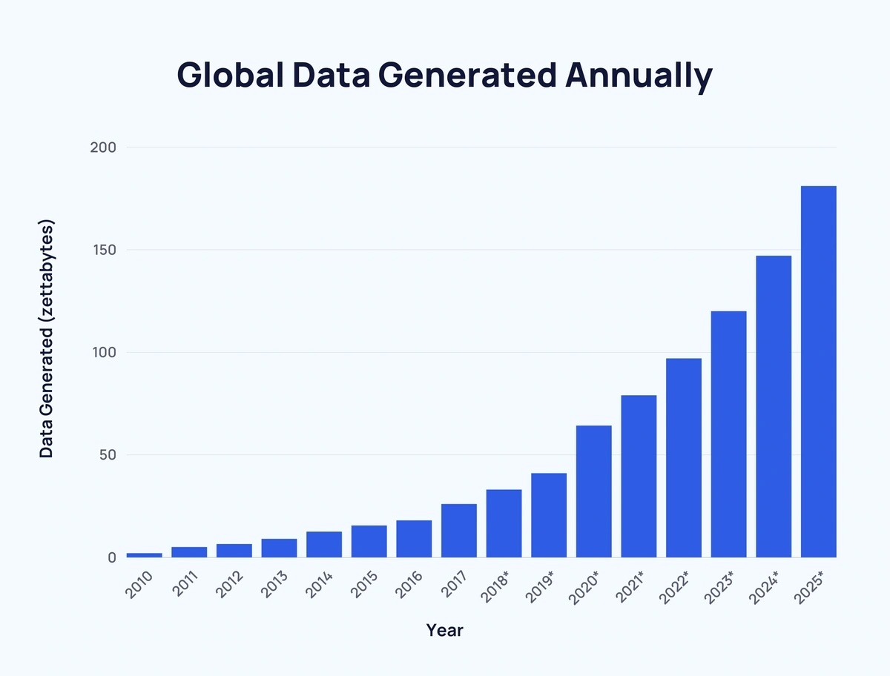
Data is everywhere
In 2015 the healthcare industry alone produced 1.2 billion clinical documents.
The amount of text data generated annually (digital forms, social media, online portals, pdf reports, emails, text messages) is ever increasing
Holmes, Dawn E., 'The data explosion', Big Data: A Very Short Introduction, Very Short Introductions (Oxford, 2017; online edn, Oxford Academic, 23 Nov. 2017), https://doi.org/10.1093/actrade/9780198779575.003.0001)

Slide 4

https://wol.iza.org/articles/big-data-in-economics

Slide 5
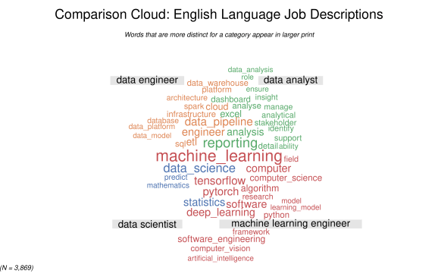
Need a job? Learn how to work with data
Data analyst: emphasis on being able to interpret and communicate findings (insight, reporting)
Data literacy is the ability of an individual to read, understand, and work with data to create meaningful insights
https://www.r-bloggers.com/2022/04/text-analysis-of-job-descriptions-for-data-scientists-data-engineers-machine-learning-engineers-and-data-analysts/

Slide 6
Intended Audience
Students who want to:
serve as research assistants
conduct empirical analyses
are interested in Data Science careers.
Prerequisites: Econ 101 (Statistics)
No prior programming experience is needed

Slide 7
Course Objectives
Master the ability to collect, process, interpret, analyze raw data using R.
Develop visualization skills necessary to summarize data findings
Communicate findings to various audiences and in various formats.

Slide 8
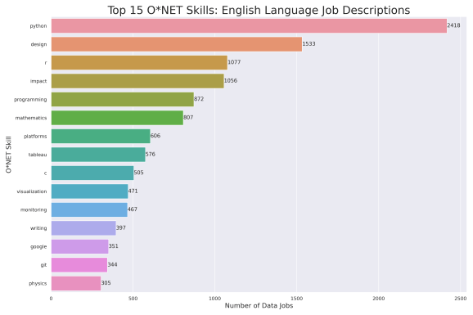
Why are we using R in this course?
Advantages of R:
It’s free and open source
It’s widely used in industry
It has a large and active user community
More of a true programming language compared to Stata

Slide 9
R vs. Python
R:
Built for statistics and data analysis
Better at econometrics and data visualization
Python:
Built for general-purpose programming and software development
Better at machine learning

Slide 10
R is a means, not an end
The goals of this course are platform-agnostic
It’s not about the syntax of specific packages
It’s about the concepts, logic, and thought processes underlying what we're doing and why
Your eventual goal: Use the right tool for the job
You will likely learn all these tools at some point.

Slide 11
Grading
Assignment | Points
Lab Assignments | 40
Poll Everywhere | 10
Project Milestones | 30
Final Project | 20
TOTAL | 100

Slide 12
Lab Assignments
Lab assignments: gives you the opportunity to practice the data skills covered during lecture
Two components: writeup and R script
Due on Sundays at 11:59pm
I will drop the lowest lab score at the end of the quarter

Slide 13
Research Project
The goal of this class is to give you the skills to conduct your own small research project.
Three project milestones will walk you through the research process
All three will count toward your final grade (no drops)
Final product:
Writeup (~1500 words)
documentation (r scripts)

Slide 14
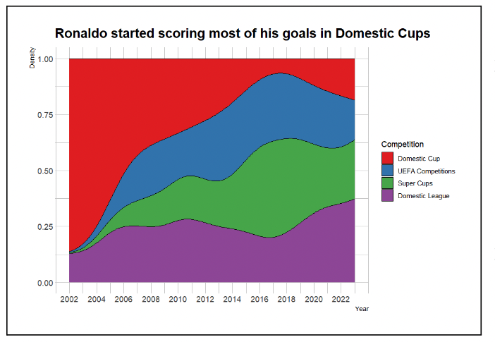
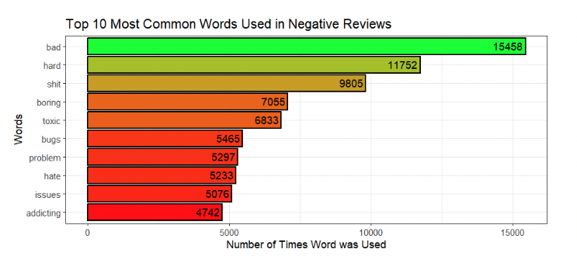
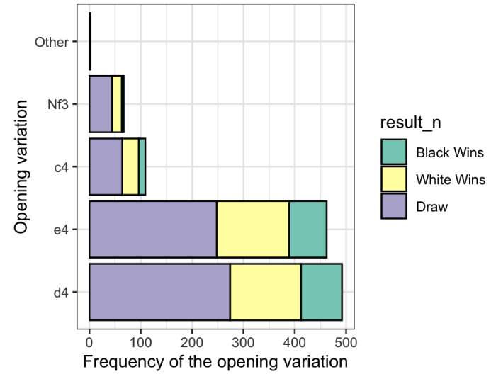
Examples of Student Work

Slide 15
ChatGPT/Generative AI
It is up to you whether you want to use generative AI to help you with your code
Guidelines:
The code has to use the tools covered in lecture
You cannot use it for the written portion of lab assignments or research milestones
You need to state whether you used it for your code and how.

Slide 16
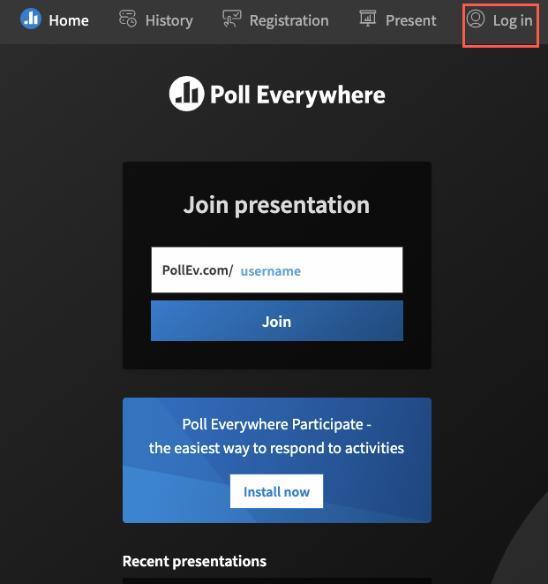
Poll Everywhere
I use Poll Everywhere to encourage active learning during lecture
My polls will be available here when they go live: PollEv.com/vsovero

Slide 17
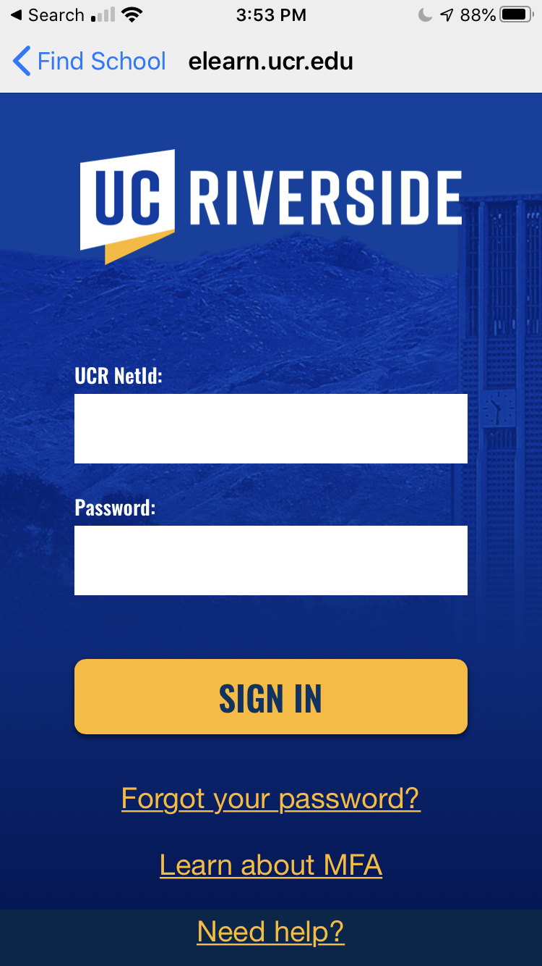
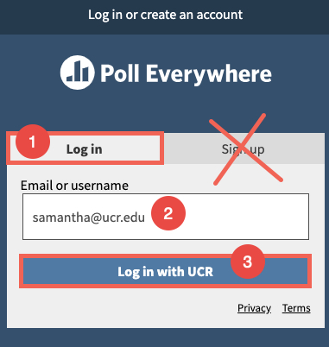
Poll Everywhere
Please use your ucr email address to sign in (do not sign up for an account)
You will be redirected to the UCR SSO

Slide 18
Lecture Quizzes (ungraded)
Posted on Canvas for you to practice after lecture
Does not count towards your grade
Feel free to ask Fan to review these questions during lab section

Slide 19
Lecture Scripts
I post all of the code used during lecture as an R script on Canvas
Running the code during or after lecture will help you gain more familiarity with Rstudio

Slide 20
This Week: Introduction to R Basics
Before we cover more broad topics in data analysis, we need to understand some R basics
We need these building blocks before moving onto data wrangling, visualization, etc.

Slide 21
Coding Goals
Run code without errors (pretty doable with ChatGPT)
Run code that produces what you were expecting
Run code that produces what you were expecting and you understand

Slide 22
Getting help
Read the error message.
Try some online resources:
Stack Overflow
ChatGPT (type in your code and the error message)
Slack
Still stuck?
Please reach out to myself or your TA (Fan Bu)
Share your code, data, screenshots of the error message, etc.

Slide 23
Example: Be Careful with Typos
Implicit contract with the computer / scripting language:
Computer will do tedious computation for you.
In return, you will be completely precise in your instructions
Typos matter. Case matters.
data_rocks <- 2 ^ 3
datarocks
#> Error in eval(expr, envir, enclos): object ‘datarocks' not found
Data_rocks
#> Error in eval(expr, envir, enclos): object ‘Data_rocks' not found

Slide 24


What is R? RStudio?
R – a programming language + software that interprets it
RStudio – popular software to write R scripts and interact with the R software
We will be using Rstudio in this course (however you need to install R in order for it to run correctly)
Notes:
for these exercises, you’ll need to install both R and RStudio.
· R is the programming language that we’ll be using in these exercises. It comes with software that will interpret and run the commands we write.
· RStudio is a “fancier” interface that we will use to write R scripts and interact with the R software.
· If you need help installing R and Rstudio, please see the installation instructions from Data Carpentry linked to on this slide. (http://www.datacarpentry.org/R-ecology-lesson/#setup_instructions)

Slide 25
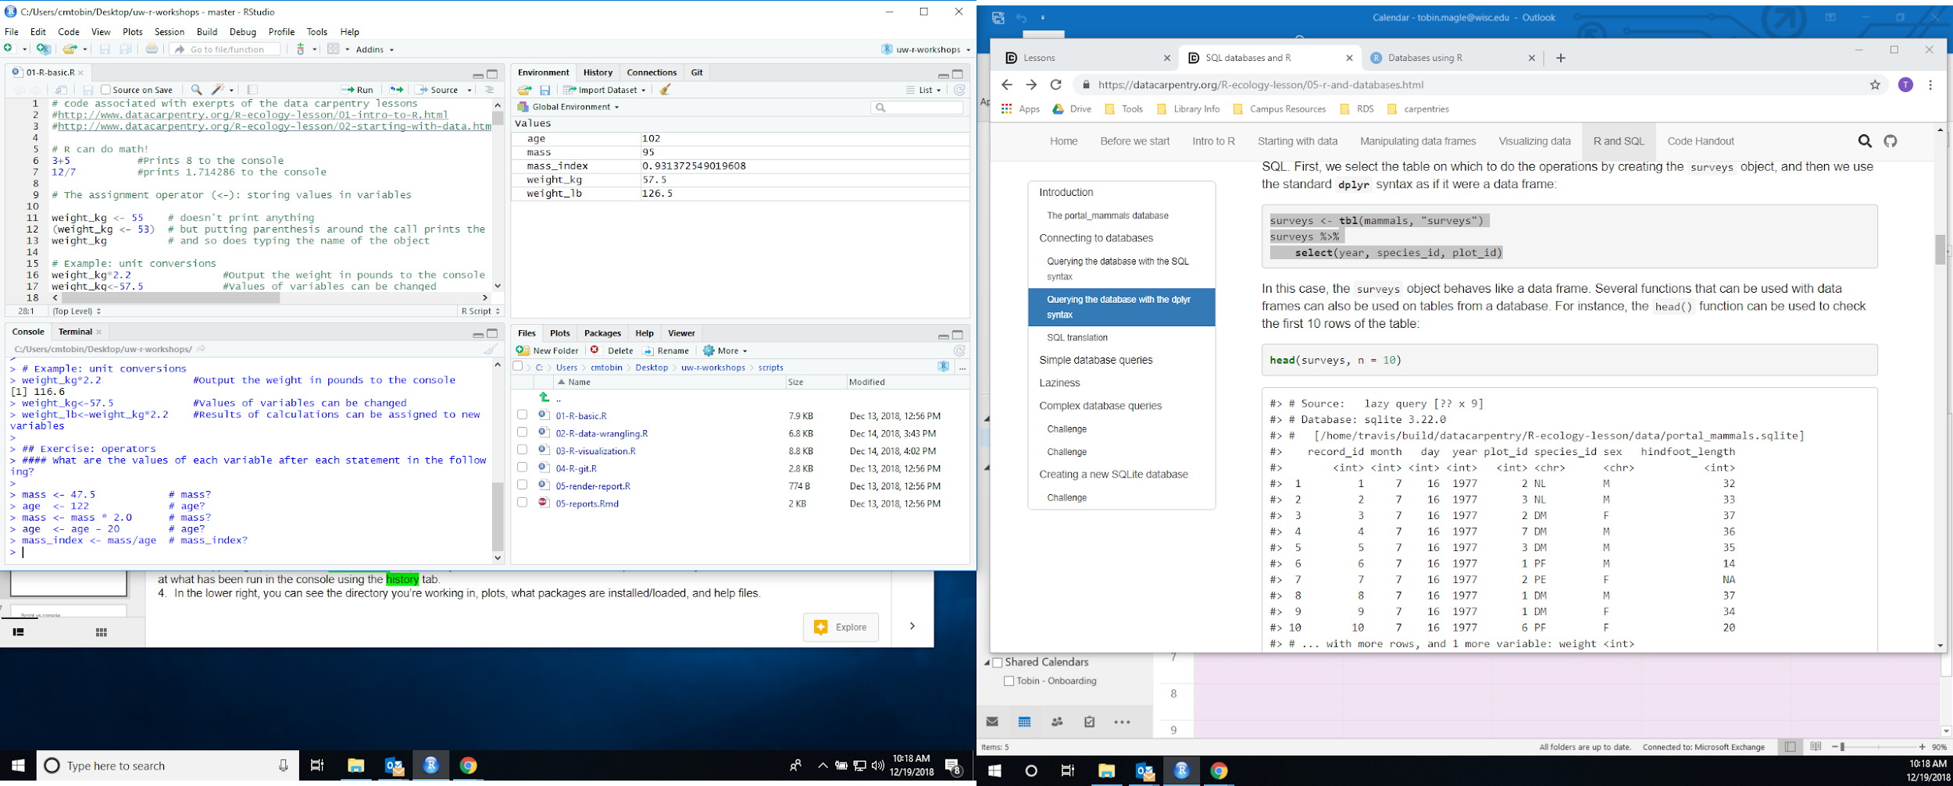
R Studio Interface
Script
Environment
Console
Files
Notes:
Now your workspace should look roughly like this
In the upper left, we have the script window. This is where you edit the text document that holds your code. The name of the file on the tab turns red when the file is not saved.
In the lower left, we have the console. This is where the code gets executed and output, such as warnings and error messages, are displayed.
In the upper right, we have the environment tab, where you can see data stored in the computer’s memory. You can also look at what has been run in the console using the history tab.
In the lower right, you can see the directory you’re working in and what files are contained in the directory

Slide 26
RStudio Console
You can input and execute commands directly in the console.
Output of certain commands will be displayed in the console.
Console

Slide 27
Rstudio Script Editor
Most data analysis will require several steps
The script editor is used to record the steps (commands) we take to analyze our data
WRITE
Notes:
You have probably noticed that we have two places that accept code as input: the script and console windows:
Both of these windows will accept R commands
The Console runs the commands, but doesn’t save them permanently, though they appear in the history tab on the upper right
The script is where you save commands to run later. Once you type them in the script, you still need to send them to the console to be run.
You can do this by copying and pasting, or putting your cursor on the line that you want to run, and pressing control enter on PC and command enter on the mac.

Slide 28
Rstudio Script Editor
Once you type them in the script, you still need to send them to the console to be run.
Scripts are saved with the .R extension (“lecture1.R”)
WRITE
Ctrl-Enter
RUN
Notes:
You have probably noticed that we have two places that accept code as input: the script and console windows:
Both of these windows will accept R commands
The Console runs the commands, but doesn’t save them permanently, though they appear in the history tab on the upper right
The script is where you save commands to run later. Once you type them in the script, you still need to send them to the console to be run.
You can do this by copying and pasting, or putting your cursor on the line that you want to run, and pressing control enter on PC and command enter on the mac.

Slide 29
Commenting in Scripts
R ignores the rest of a line after a #
write notes to yourself about what your code is doing
comments are automatically in green

Slide 30
Let’s start coding!
An operator is a symbol that tells R to perform some sort of operation.
Types of Operators:
math (arithmetic)
logical (compare values)
assignment (saving values to objects)
extraction (take out/replace parts of objects)
Notes:
Now that we’re oriented to the R studio interface, let’s start coding! We’re going to be discussing operators, functions and data types. Let’s start with operators

Slide 31
Operators
https://www.statmethods.net/management/operators.html
Type | What it does | Symbol(s)
Arithmetic | Math on numbers | + - * / ^
Logical | Compares values | > < == != & |
Assignment | Assigns values to objects | <-
Extraction | Take out or replace part of an object | [ ] $
Notes:
An operator is a symbol that tells R to perform some sort of operation.
we’ll be working with Assignment, Arithmetic, Extraction and Logical operators in this lesson.
For more information on operators, please see: https://www.statmethods.net/management/operators.html

Slide 32
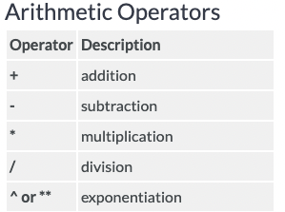
Arithmetic operators
Does math:
Add: 2 + 2
Subtract: 3 - 1
Multiply: 4 * 4
Divide: 5 / 2
Exponent: 5^2
Ctrl/Cmd+Enter to run
Results in the Console
Notes:
Arithmetic operators allow R to do math like add, subtract, multiply, and divide on numbers or variables.
These operators are useful with data because they allow us to compute unit conversion
By default, the result of the mathematical computations goes to the console.
But what if we want to save the results?

Slide 33
Example: Who left a larger Tip?
Louberto’s bill at Shake Shack came out to $25
He tips 15%
Louie’s bill at Shake Shack came out to $32
He tips 12%
Use operators to calculate how much Louie and Louberto tipped

Slide 34
Functions
For more complicated tasks, R also comes pre-installed with a variety of functions.
Functions are a sequence of instructions that perform a task
Have names
Accept arguments (input)
Return a value (output)
Input | Output
round(x = 3.14159, digits = 0) | 3
Notes:
For more complicated tasks, R also comes pre-installed with a variety of functions. Functions are a sequence of steps that perform a specific task.
Each function has a name
They accepts input in the form of arguments,
and returns a value that can be assigned to a variable as output.
Some examples of R functions are square root and round. Let’s see how they work.
Demo 2: Functions
round(3.14159) #Round is the function, 3.14159 is the argument, output printed
args(round) #lists the argument of the round function to the console
?round #loads the documentation for the round function
round(3.14159, digits =2) #Rounds the output to 2 digits

Slide 35
Arguments
Input | Output
round(x = 3.14159, digits = 0) | 3
round(3.14159) | 3
To find out what arguments a function takes, look up its help file (type ?round)
Some arguments are required, some are optional.
You can see that digits is optional because you don’t need to include it and you will get the same output

Slide 36
Arguments
Input | Output
round(x = 3.14159, digits = 2) | 3.14
round(3.14159, 2) | 3.14
You technically don’t even need to write out the names of the arguments (x, digits) if values are in the correct order
However, it’s much easier to understand your code when you write out the name of the argument

Slide 37
Assignment operator
<-
Saves values into objects
object <- value
weight_kg <- 55
Overwrites previous values
Can be combined with other operators
weight_lb <- 2.2*weight_kg
(alt/option - dash)
Notes:
To save the results of mathematical computations, we use the assignment operator, which is symbolized by the left carat and a dash with no spaces in between
This operator assigns a value to a variable.
For example, we can assign the value 55 to the variable weight_kg.
The values in these variables can be overwritten by a second assignment operation.
Let’s look at operators in action.
Demo: Operators
# R can do math!
3+5 #Prints 8 to the console
12/7 #prints 1.714286 to the console
# The assignment operator (<-): storing values in variables
weight_kg <- 55 # doesn't print anything
(weight_kg <- 55) # but putting parentheses around the call prints the value of
weight_kg # and so does typing the name of the object
##### Example: unit conversions
weight_kg*2.2 #Output the weight in pounds to the console
weight_kg<-57.5 #Values of variables can be changed
weight_lb<-weight_kg*2.2 #Results of calculations can be assigned to new variables

Slide 38
Naming Objects
Object names:
cannot start with a digit
cannot contain certain other characters such as a comma or a space.
Tips:
Make it as descriptive as possible
Use underscores to mark spaces
#this is good
weight_kg <- 55
#not these
weightkg! <- 55
weight in kg <- 55
blah <- 55

Slide 39
Where are my objects?
You can see your objects in the workspace (top right pane of Rstudio)
You can also get a listing of these objects with commands:
ls()
objects()

Slide 40
Checking Values of an Object
If you want to inspect the values of an object, type the name of the object in the console
weight_kg <- 55
weight_kg

Slide 41
Example: Who left a larger Tip?
Louberto’s bill at Shake Shack came out to $25
He tips 15%
Louie’s bill at Shake Shack came out to $32
He tips 12%
Use the assignment operator to save how much Louie and Louberto tipped (create 6 objects)

Slide 42
Removing Objects
#remove object called y
rm(y)
#remove everything in your workspace
rm(list = ls())
Sometimes when you have Rstudio open for a while, your workspace gets cluttered up with objects
You can remove objects with commands (right) or by clicking the broom icon in Rstudio’s Environment pane

Slide 43
Objects: Not Just for Storing Numbers
Basic Data types:
Character
Numeric
 | type
x <- 32 | numeric
y <- "hi" | character

